Slide 1

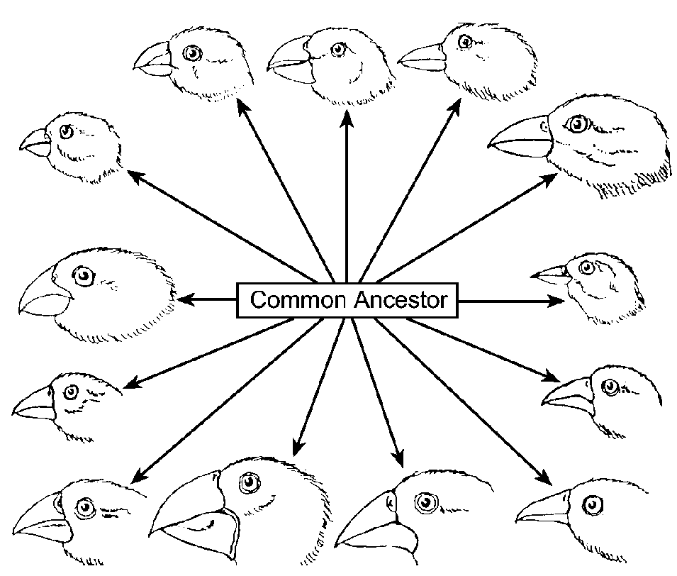
The Beaks of Finches

Slide 2

Variations in the Beaks of Finches

Slide 3
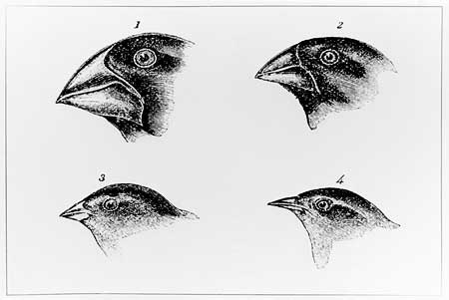
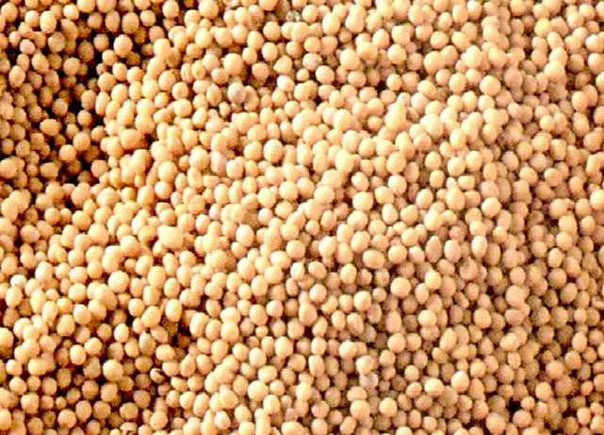
Predict which beak is best adapted or least adapted to feed on the following seed. Explain your answer.

Slide 4
Describe the characteristics that would be required to pick up small seeds.

Slide 5
ROUND 1
NO COMPETITION
USE ONLY ONE GROUP RESULTS

Slide 6
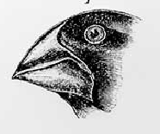
Group A
TRIALS | SEEDS Collected
1 | 26
2 | 27
3 | 23
4 | 28
Ave: | 26

Slide 7
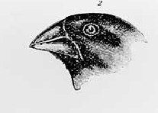
GROUP B
TRIALS | SEEDS Collected
1 | 15
2 | 18
3 | 19
4 | 19
Ave: | 18

Slide 8
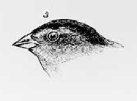
GROUP C
TRIALS | SEEDS Collected
1 | 10
2 | 17
3 | 18
4 | 11
Ave: | 14

Slide 9
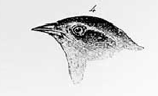
GROUP D
TRIALS | SEEDS Collected
1 | 15
2 | 10
3 | 9
4 | 17
Ave: | 13

Slide 10
Which beak was the successful at picking up small seeds?

Slide 11
ROUND 2:
COMPETITION BETWEEN 2 GROUPS
USE ONLY ONE GROUP RESULTS

Slide 12
COMPETITION: GROUP A&B
VS
TRIAL | GROUP A | GROUP B
1 | 20 | 18
2 | 18 | 12
3 | 17 | 15
4 | 25 | 11
AVE | 20 | 14

Slide 13
COMPETITION: GROUP C&D
VS
TRIAL | GROUP C | GROUP D
1 | 16 | 9
2 | 13 | 10
3 | 11 | 11
4 | 11 | 11
AVE | 13 | 10

Slide 14
ROUND 3:
COMPETITION BETWEEN 3 GROUPS
USE ONLY ONE GROUP RESULTS

Slide 15
COMPETITION BETWEEN GROUP A, B &C.
TRIAL | GROUP A | GROUP B | GROUP C
1 | 18 | 14 | 5
2 | 20 | 12 | 7
3 | 17 | 11 | 10
4 | 13 | 11 | 9
AVE | 17 | 12 | 6

Slide 16
What characteristics would interfere with the feeding success?
Size of the beak
Length of beak
Thickness of beak
Shape (curve or straight) of beak

Slide 17
Other characteristics that would allow finches to complete successful
Speed
Eye sight
Coloration

Slide 18
Mutations can affect:
Size
Shape
Curvature
Other possible answers

Slide 19
Why did some “beak” types survive on the new island when they could not survive on the original island?
New type of food source which required different adaptations
Possibly less competition

Slide 20
Did those who are successful in Round 1 survive equally well in Round 2?
No; there was more competition for the limited resources.

Slide 21
Why were there fewer survivors at the end of Round 3?
There was less food for the three populations, more competition and a greater struggle for survival.

Slide 22
Were the beaks on the new island the same as those on the original island?
No; there were different food sources which selected for finches with different beak adaptations.

Slide 23
Natural Selection
Variation: mutation and sexual reproduction produced finches with many different types of beaks.
Competition: limited amount of food, and occupying the same niche and habitat increase competition.
Struggle for survival: overpopulation, limited resources and the competition make it difficult to survive and reproduce.

Slide 24
Natural Selection
Adaptation: any favorable feature or trait that allows an organism to survive its environment e.g.. Beak size, shape, etc.
Environment: the abiotic and biotic factors
Selective Agent: any factor that affects the survival of an organism in its habitat i.e. biotic or abiotic factors (food, temperature, light, predator, etc)

Slide 25
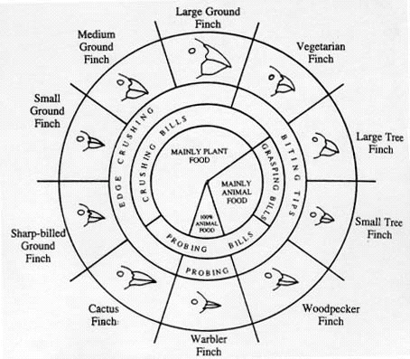
Finches of Galapagos Islands

Slide 26
How would two species occupy the same habitat?
Two species could occupy the same habitat if they occupy different niches e.g. the ground finches eat mainly plant food, the small tree finches eat mainly animal food.
If another type of finch (e.g. sharp-billed ground finch) came into the area, competition may occur between the new finches and the native populations. The best adapted finches will survive and reproduce.

